Slide 1



The Effects of Associative Direction on Judgment of Learning Reactivity
Nicholas P. Maxwell & Mark J. Huff

Slide 2
Introduction
Metacognitive judgments are commonly used to obtain information about the learning process
Judgments of Learning (JOL) – How likely to respond w/ cue if shown only target at test
JOLs may be reactive
Positive Reactivity – Increases in memory performance
Negative Reactivity – Costs to memory performance

Slide 3
Introduction
Changed-Goal Hypothesis vs Strategic Relational Encoding
Changed-goal – participants focus on mastering easy study items
Strategic relational encoding – JOLs cause participants to engage in relational encoding for related study pairs
Changed-goal predicts positive reactivity for related pairs, negative reactivity for unrelated pairs.
Strategic relational encoding predicts positive reactivity for related pairs, no reactivity for unrelated pairs.

Slide 4
Overview of Experiments
Experiment 1 – JOLs vs No-JOLs
H1: Positive reactivity for related pairs, no reactivity for unrelated pairs
Experiment 2 – JOLs vs Relational Encoding vs Vowel Counting vs No-JOL
H1: Relational encoding should mimic JOL reactivity for related pairs and should also boost recall of unrelated pairs
Experiment 3 – JOLs vs Frequency Judgments vs No-JOLs
H1: Frequency judgments should display the same reactivity pattern as JOLs
Study
Arithmetic Filler Task
Recall
40 forward (e.g., Credit-Card), backward (e.g., Card-Credit), symmetrical (e.g., King-Queen), and unrelated (e.g., artery-bronze) pairs were generated using the Nelson et al. (2004) free association norms.
Study lists were matched on FSG, length, concreteness, and frequency.

Slide 5
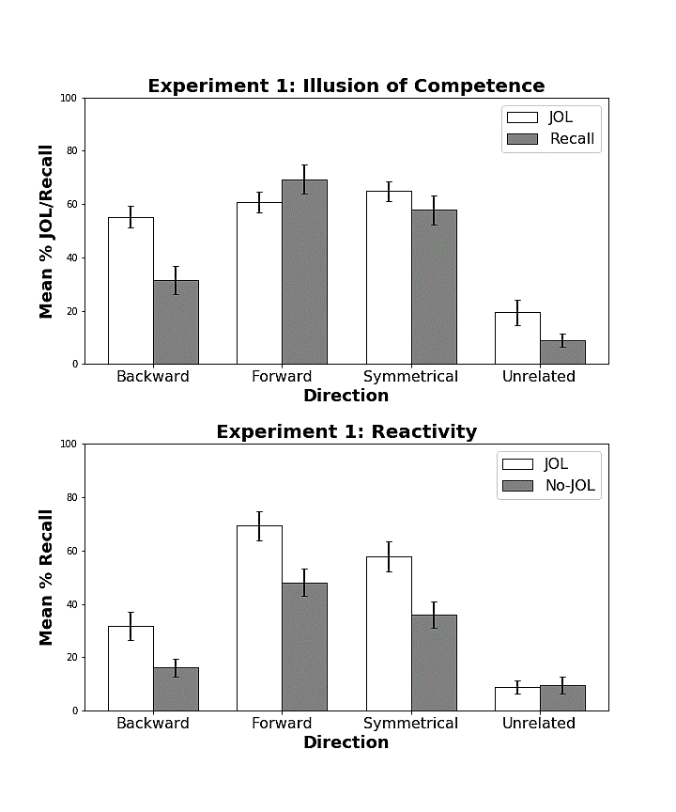
Results

Slide 6
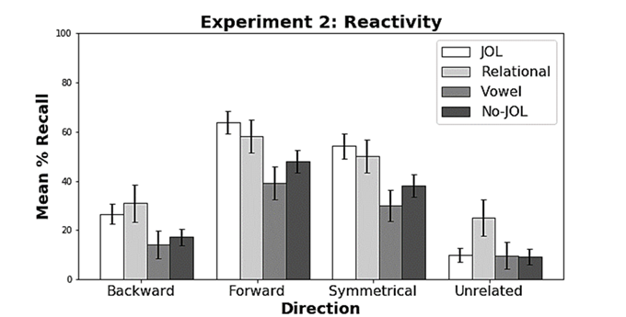
Results

Slide 7
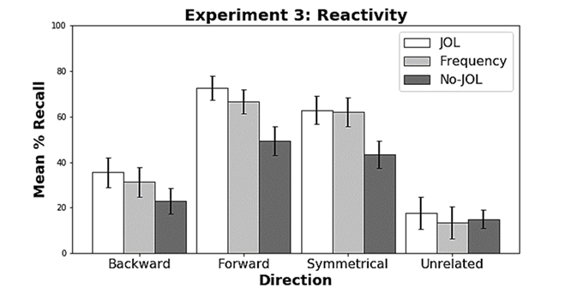
Results

Slide 8
Conclusion
Strategic relational encoding provides a better explanation of JOL reactivity than the changed-goal hypothesis or testing cues.
It’s not the act of making a JOL that results in reactivity, but the relational encoding that occurs as a byproduct
JOLs aren’t a requirement for JOL reactivity!

